Slide 1

RUNGTA COLLEGE OF DENTAL SCIENCES & RESEARCH
TITLE OF THE TOPIC
SPREAD OF ORAL INFECTIONS
DEPARTMENT OF ORAL PATHOLOGY & MICROBIOLOGY

Slide 2
SPREAD OF ORAL INFECTIONS
GUIDED BY:-
DR SIDDHARTH PUNDIR
DR SUDHANSHU DIXIT

Slide 3
Specific learning Objectives
Core areas* | Domain ** | Category #
CELLULITIS (PHLEGMON) | COGNITIVE | MUST KNOW
INFECTIONS SPREAD VIA TISSUE SPACE | COGNITIVE | MUST KNOW
PRINCIPLES IN TREATMENT OF ORAL INFECTIONS | COGNITIVE | MUST KNOW
LUDWIGS ANGINA | COGNITIVE | MUST KNOW
MAXILLARY SINUSITIS | COGNITIVE | MUST KNOW

Slide 4
Table of Content
CELLULITIS (PHLEGMON)
INFECTIONS SPREAD VIA TISSUE SPACE
PRINCIPLES IN TREATMENT OF ORAL INFECTIONS
LUDWIGS ANGINA
MAXILLARY SINUSITIS

Slide 5

Cellulitis (Phlegmon)
Defination :-
Cellulitis is a diffuse inflammation of connective tissue with severe inflammation of dermal and subcutaneous layers of the skin. It is a spreading diffuse inflammatory process with formation of suppurative/purulent exudate or pus.

Slide 6
INTRODUCTION :-
Cellulitis can be caused by normal skin flora or by exogenous bacteria[streptococcus and/or staphylococcus bacteria].
Often occurs where the skin has previously been broken: cracks in the skin, cuts, blisters, burns, insect bites, surgical wounds, or sites of intravenous catheter insertion.
Skin on the face is most commonly affected by this infection, though cellulitis can occur on any part of the body.
The mainstay of therapy remains treatment with appropriate antibiotics, and recovery periods can be anything from 48 hours to six months.

Slide 7
It appears as localized inflammation of the skin and is characterized by redness (erythema), swelling (edema), tenderness or pain, and warmth.
Cellulitis can remain a superficial infection or spread into the soft tissues immediately below the skin that contain blood vessels, lymphatic vessels, and nerves.
It can also involve the underlying muscle or spread throughout the body via the lymphatic system and the bloodstream.
Cellulitis is unrelated (except etymologically) to cellulite, a cosmetic condition featuring dimpling of the skin.

Slide 8
Histological features
A microscopic section through an area of cellulitis shows a diffuse exudation of poly morphoneuclear leukocyte and lymphocyte.
With considerable serous fluid and fibrins causing separation of connective tissue and muscle fibres.

Slide 9
Treatment
Treatment consists of resting the affected area, cutting away dead tissue, and antibiotics (either oral or intravenous).
Flucloxacillin or Dicloxacillin monotherapy (to cover staphylococcal infection) is often sufficient in mild cellulitis, but in more moderate cases, or where streptococcal infection is suspected, then this course is usually combined with oral phenoxymethylpenicillin or intravenous benzylpenicillin, or ampicillin/amoxicillin

Slide 10
Infection spread via tissue spaces

Slide 11
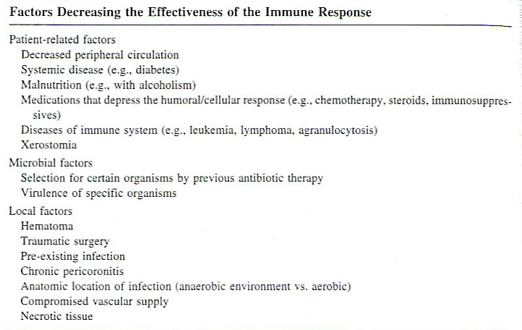

Slide 12
Clinical Features
Inflammation is tissue response to injury or invasion by microorganisms that involves vasodilation, capillary permeability, mobilization of leukocytes, and phagocytosis.
Cardinal signs of inflammation:
Red, hot, swelling, pain, with loss of function
Other findings: regional lymphadenopathy, fever, elevated white blood cell count, tachycardia, tachypnea, dehydration, malaise.

Slide 13
Infection can spread via the blood, lymph and the tissue spaces. In dentistry, the most relevant tissue spaces are the:
Pterygomandibular space
Lateral pharyngeal space
Retropharyngeal space
Infratemporal fossa
Buccal space
Vestibular space
Sublingual space
Submandibular space
Submental space

Slide 14
Infection spread from maxillary teeth
Infections from the maxillary teeth can spread to the maxillary sinus, the canine fossa, palatal space, infratemporal fossa, buccal space and vestibular space.
Infection will spread to the buccal space if the infection's path is outside the attachment of the buccinator muscle, but will spread to the vestibular space if the infection's path is inside the attachment of the buccinator muscle.
Infection can spread to the cavernous sinus from the infratemporal fossa and from the canine fossa. Infection in the cavernous sinus can lead to cavernous sinus thrombosis, which is potentially fatal.

Slide 15
Infection spread from mandibular teeth
Infections from mandibular teeth can spread to the vestibular and buccal space in the same way as from the maxillary teeth.
Infection can also spread to the pterygomandibular space, sublingual space, submandibular space and submental space.
The sublingual, submental and submandibular spaces can be referred collectively as the submandibular spaces.
Sometimes when an infection spreads to the submandibular spaces a life threatening condition called Ludwig's angina occurs. Angina is latin for strangle therefore this angina is referring to the sensation of being strangled caused by the swelling of the neck region. Tracheotomy is sometimes necessary to maintain the airway.

Slide 16
Fascial Spaces
Fascial planes offer anatomic highways for infection to spread superficial to deep planes
Antibiotic availability in fascial spaces is limited due to poor vascularity
Treatment of fascial space infections depends on I and D
Fascial spaces are contiguous and infection readily spreads from one space to another (open primary and secondary spaces)
Despite I and D the etiologic agent (tooth) must be removed

Slide 17
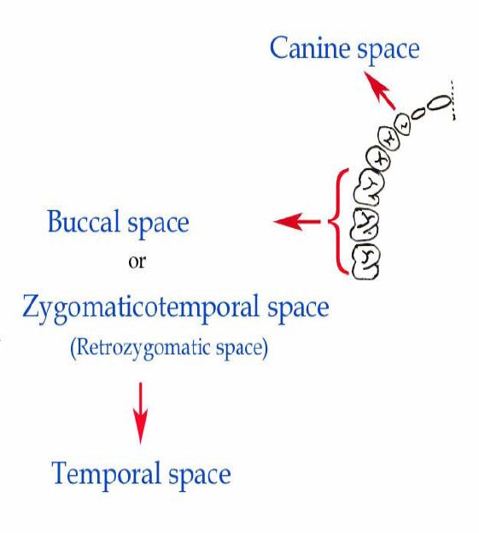

Slide 19
Canine Space
Location: between the levator anguli oris and the levator labii superioris muscles
Involvement primarily due to maxillary canine tooth infection
Long root allows erosion through the alveolar bone of the maxilla
Signs:
Obliteration of the nasolabial fold
Superior extension can involve lower eyelid

Slide 20
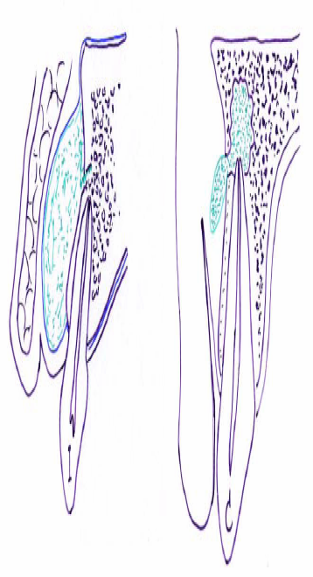

Slide 21
Buccal Space
Posterior maxillary teeth are source of most buccal space infections
Results when infection erodes through bone superior to attachment of buccinator muscle
Boundaries:
Lateral-Skin of the face
Medial-Buccinator muscle
Both a primary mandibular and maxillary space
Most infections caused by posterior maxillary teeth

Slide 22
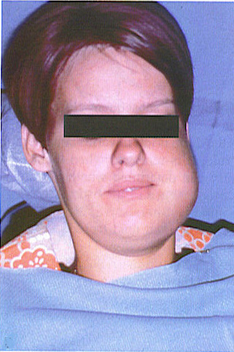
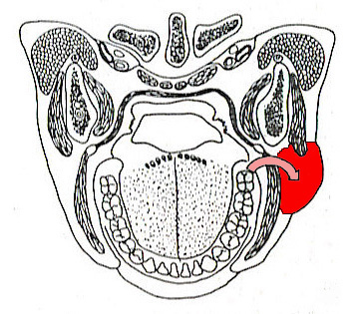
Pathway of spread for buccal space infection

Slide 23
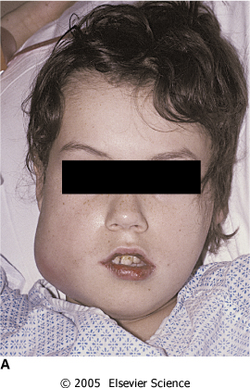
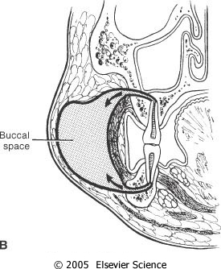

Slide 24
Infratemproal space
Infratemproal space is a potential space lying behind the maxilla.
Boundaries of infratemporal fossa: 1. Lateral: Bounded by Zygoma, ramus of mandible, parotid gland and masseter muscle. 2. Medial: Bounded by superior constrictor muscle, Pharyngobasilar fascia, Pterygoid plates. 3. Anterior: The body of maxilla lies anteriorly. 4. Superior: Greater wing of sphenoid. 5. Posterior: Auricular tubercle of the temporal bone, glenoid fossa and styloid process.

Slide 25
INFECTION OF INFRATEMPORAL SPACE
Infective complications can develop and present following the extraction of clinically non-infected teeth
Infratemporal space infection is a rare complication of dental extraction
The cardinal clinical signs of maxillary and mandibular neurosensory deficit may not be immediately apparent
The diagnosis, as in this case, can only be confirmed using scanning imaging modalities (CT or MRI)

Slide 26
Clinical features :-
Severe trismus
Buldging of temporalis muscle
Swelling extraorally over the region of sigmoid notch and intraorally in tuberosity region.

Slide 27
Pterygomandibular space
The space between the medial area of the mandible and the medial pterygoid muscle, a target area for administering local anesthesia to the inferior alveolar nerve.

Slide 28
Boundaries of pterygomandibular space
Medially – medial pterygoid muscle
Laterally – medial surface of ramus of mandible
Superiorly – lateral pterygoid
Posteriorly – deep lobe of parotid gland
Inferiorly – attachment of medial pterygoid oto the mandible
Anteriorly – pterygomandibular raphe

Slide 29
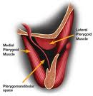

Slide 30
Parotid space
A deep hollow on the side at the sides of the face flanking the posterior aspect of the ramus of the mandible with its attached muscles which is occupied by the parotid gland; it is lined with fascial laminae (the parotid sheath) derived from the investing layer of deep cervical fascia; the structures bounding the space collectively constitute the parotid bed.

Slide 31
Clinical features
Facial swelling and progressive trismus are described.
Intraoral wound drainage and prolonged antibiotic therapy failed to control the resultant chronic cellulitis.

Slide 32
Submental space
Infection can result directly due to infected mandibular incisor or indirectly from the submandibular space
Space located between the anterior bellies of the digastric muscle laterally, deeply by the mylohyoid muscle, and superiorly by the deep cervical fascia, the platysma muscle, the superficial cervical fascia, and the skin
Dependent drainage of this space is performed by placing a horizontal incision in the most dependent area of the swelling extraorally with a cosmetic scar being the result

Slide 34
Submandibular Space
Boundaries:
Superior-mylohyoid muscle and inferior border of the mandible
Anteriorly-anterior belly of the digastric muscle
Posteriorly-posterior belly of the digastric muscle
Inferiorly-hyoid bone
Superficially-platysma muscle and superficial layer of the deep cervical fascia
Infected mandibular 2nd and 3rd molars cause submandibular space involvement since root apices lay below mylohyoid muscle

Slide 35
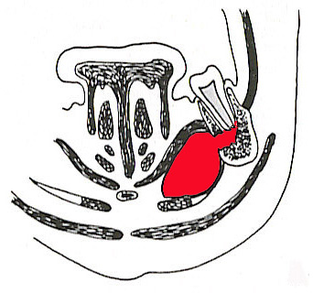
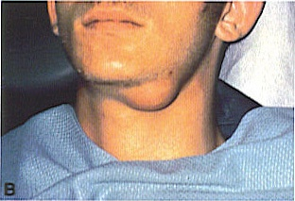
Pathways of spread of submandibular space infection from mandibular molar

Slide 36
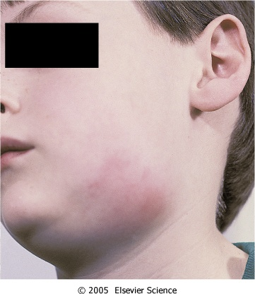
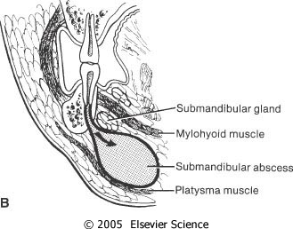

Slide 37
Sublingual Space
Submandibular and sublingual spaces surgically distinct, but should be considered as surgical unit due to proximity and frequent dual involvement in odontogenic infections.
Boundaries:
Superior-oral mucosa
Inferior-mylohyoid muscle
Infected premolar and 1st molar teeth frequently drain into this space due to their root apices existing superior to the mylohyoid muscle

Slide 38
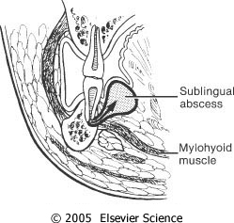

Slide 39
Masseteric Space
Located between lateral aspect of the mandible and the masseter muscle
Involvement of this space generally occurs from buccal space primary involvement
Signs of involvement of the masseteric space include trismus and posterior-inferior face swelling

Slide 40
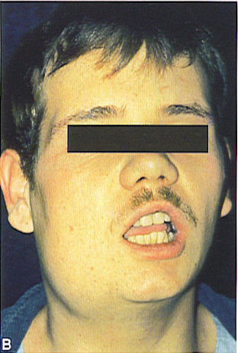
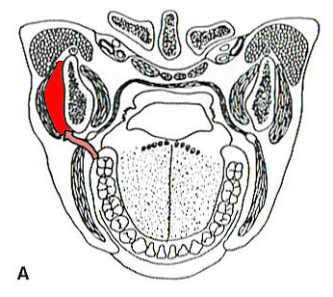
Pathway of spread from masseteric space infection

Slide 41
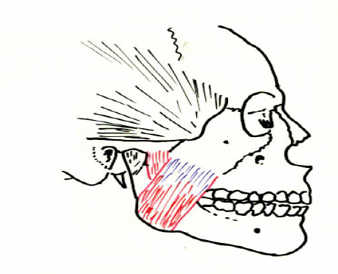
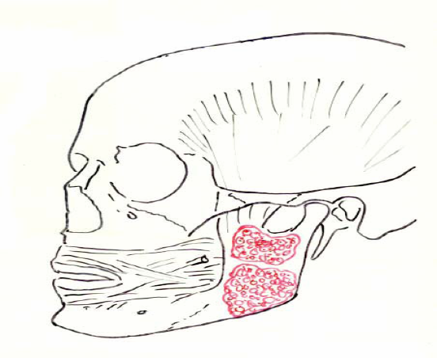

Slide 42
Principles in Treatment of Oral Infections
Remove the cause.
Establish drainage.
Institute antibiotic therapy.
Supportive care, including proper rest and nutrition.

Slide 43
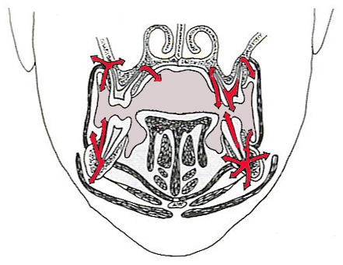
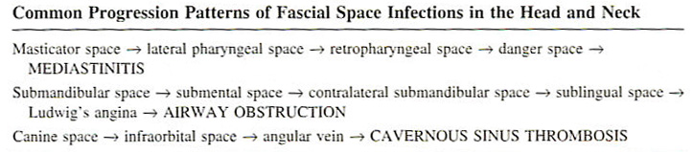
Potential Pathways of Spread of Oral Infections

Slide 44
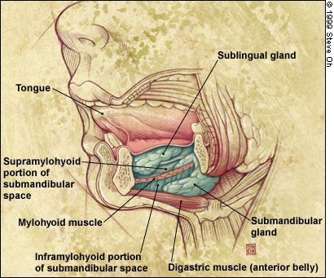
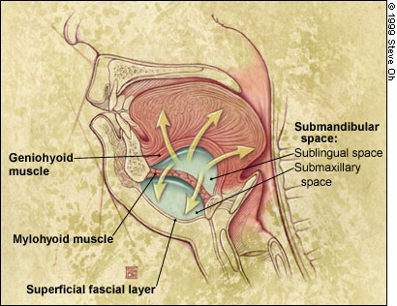
Ludwig’s Angina

Slide 45
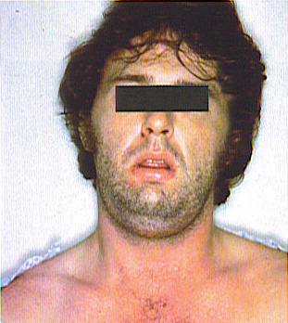
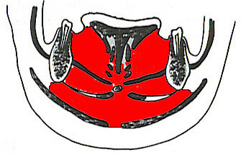
Ludwig’s angina with bilateral involvement of sublingual and submandibular spaces

Slide 46
DEFINiTION
Ludwig's angina, , is a serious, potentially life-threatening cellulitis[1], or connective tissue infection, of the floor of the mouth, usually occurring in adults with concomitant dental infections.
It is named after the German physician, Wilhelm Friedrich von Ludwig who first described this condition in 1836.[2][3] Other names include "angina Maligna" and "Morbus Strangularis".
Ludwig's angina should not be confused with angina pectoris, which is also otherwise commonly known as "angina".
The word "angina" comes from the Greek word ankhon, meaning "strangling"

Slide 47
Causes
The cause is usually an infection with Streptococcal bacteria, although other bacteria can cause the condition.
The route of infection in most cases is from infected lower third molars or from pericoronitis, which is an infection of the gums surrounding the partially erupted lower third molars.
Although the widespread involvement seen in Ludwig's is usually develops in immunocompromised persons, it can also develop in otherwise healthy individuals.
Thus, it is very important to obtain dental consultation for lower-third molars at the first sign of any pain, bleeding from the gums, sensitivity to heat/cold or swelling at the angle of the jaw.
Ludwig's angina is also associated with piercings of the lingual frenulum.

Slide 48
Symptoms
The symptoms include swelling, pain and raising of the tongue, swelling of the neck and the tissues of the submandibular and sublingual spaces, malaise, fever, dysphagia (difficulty swallowing) and, in severe cases, stridor or difficulty breathing.
Swelling of the submandibular and/or sublingual spaces are distinctive in that they are hard and classically 'boardlike'.
Important signs include the patient not being able to swallow his/her own saliva and the presence of audible stridor as these strongly suggest that airway compromise is imminent.

Slide 49
Treatment
Treatment involves appropriate antibiotic medications, monitoring and protection of the airway in severe cases, and, where appropriate, urgent maxillo-facial surgery and/or dental consultation to incise and drain the collections.
A nasotracheal tube is sometimes warranted for ventilation if the tissues of the mouth make insertion of an oral airway difficult or impossible.
In cases where the patency of the airway is compromised, skilled airway management is mandatory.
This entails management of the airway according to the American Society of Anesthesiologists' "Difficult Airway Algorithm" and necessitates fiberoptic intubation.

Slide 50
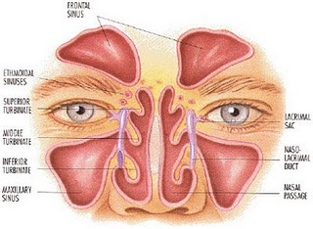
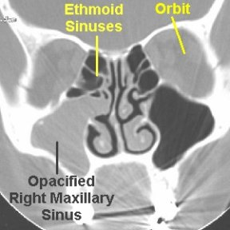
Maxillary Sinusitis
Definition of maxillary Sinusitis
Maxillary sinusitis is an inflammation of the nasal sinuses. It is usually caused by infection (bacterial or viral), but can also be caused by allergic reactions or other responses to environmental agents.

Slide 51
Causes and Risk Factors of maxillary Sinusitis
Most maxillary sinusitis is caused by infection (such as a cold or an upper respiratory tract infection) spreading to the sinuses from the nose along the narrow passages that drain mucus from the sinuses into the nose.
Allergies to dust, pollen, pet dander; indoor air pollutants, such as cigarette smoke, rug shampoo and formaldehyde (used in the manufacture of carpeting, particleboard and plywood); and outdoor air pollutants all can induce inflammation.
Excessive dryness in homes and offices from dry-air heating and air-conditioning systems can also inflame the sinuses.
Immunologic, as well as structural problems, such as narrow drainage passages, nasal obstruction (tumors, polyps or a deviated septum) problems are other possible causes of sinusitis.

Slide 52
Symptoms of maxillary Sinusitis
Maxillary sinusitis manifests as cheek or dental pain.
The classic symptoms of acute (short lasting) Maxillary sinusitis are:
Fever
Nasal obstruction
Raspy voice
Pus-like (purulent) nasal discharge
Loss of sense of smell
Facial pain or headache that is sometimes aggravated by bending over (When pain is present, this may suggest which sinus is affected.)

Slide 53
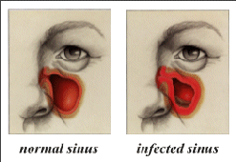
Symptoms of maxillary Sinusitis
The classic symptoms of chronic (long lasting) maxillary sinusitis are:
A dull ache or pressure across the midface, especially between or deep into the eyes
A headache that occurs daily for weeks at a time, and is often notably worse in the morning and with head movement
Nasal congestion
Postnasal drip

Slide 54
Less common signs of maxillary sinusitis include:
Sore throat
Snoring
Bad breath
Chronic throat clearing
Puffy eyes
Coughing
Stuffy ears
Fatigue, irritability and depression
A chronic cold
Asthma
Bronchitis

Slide 55

Diagnosis of maxillary Sinusitis
The doctor will examine the mouth and throat and look up the nasal passages to determine whether the sinus outlets are blocked. Additionally, the doctor may do a transillumintion or a CAT scan.
Transillumination is done in a dark room with a very bright flashlight that is pressed against the forehead or cheek. If the light shines through the sinuses, the doctor can rule out sinusitis. If little or no light penetrates, the cavity is clogged and sinusitis is evident.
CAT scan is a diagnostic technique in which the combined use of a computer and x-rays are passed through the body at different angles, producing clear, cross-sectional images of the nasal cavities.

Slide 56
Treatment of maxillary Sinusitis
If a bacterial infection is present, antibiotics, such as amoxicillin, erythromycin or sulfa drugs, are usually prescribed for about 10 days.
Your doctor also may prescribe one or more of the following remedies (which can be useful in reducing inflammation in the sinuses and nose and speeding recovery):

Slide 57
Recurring maxillary sinusitis accompanied by a bacterial infection usually requires one of the new, stronger antibiotics, such as Augmentin, Ceclor or Ceftin.
These drugs may be given in larger doses for a longer period of time (up to four weeks) than required for a brief bout of sinusitis.
The doctor may also recommend continued use of a prescription nasal inhaler for several months to keep the inflammation down and prevent a recurrence.

Slide 58
Take home message
Mouth infection spread from the root of the infected tooth through the jaw bone and into potential spaces between the fascial planes of surrounding soft tissues eventually forming an abscess

Slide 59
Question & Answer Session
WRITE ABOUT SUBMANDIBULAR SPACE INFECTIONS
DEFINE CELLULITIS
PRINCIPLES IN TREATMENT OF ORAL INFECTIONS
LUDWIG’S ANGINA

Slide 60
REFERENCES NAME OF THE BOOK WITH EDITION AND PAGE NUMBERS ARTICLE ARE TO BE MENTIONED IF NEEDED
SHAFER’S 9th EDITION
LUCAS
NEVILLE
REGEZI

Slide 61
THANKYOU

